Slide 1


Content Relay
By: Anders Bo Rasmussen

Slide 2


Overview
Introduction
01
Solution Overview
02
C4 System Context
04
C4 Container
05
Challenges
06
Collaboration
07
Conclusion
08
QA
09

Slide 3

Introduction
An application needs to be in place for content distribution. So the digital platforms can consume it.
The application must expose content and assets + metadata through an interface that can be easily consumed by digital platform developers as the briefing and order process.

Slide 4


Solution Overview
Metadata and Asset Management Service
Content Distribution Service
Acts as out ACL (Anti Corruption Layer) by aggregating data from various sources, validates, and transform them to be in line to our domain context.
Once data is transformed and validated, notifies the Content Distribution Service of the metadata through events.
Handles uploads of assets to S3 bucket.
Notifies Cloudfront CDN of new and updated assets.
Notifies Digital Platform Developers of new and updated assets through events.
Might also support Webhooks in the future.
Store metadata in DynamoDB for fast and easy retreival.
Cache metadata and S3 links in Redis for fast retreival.

Slide 5
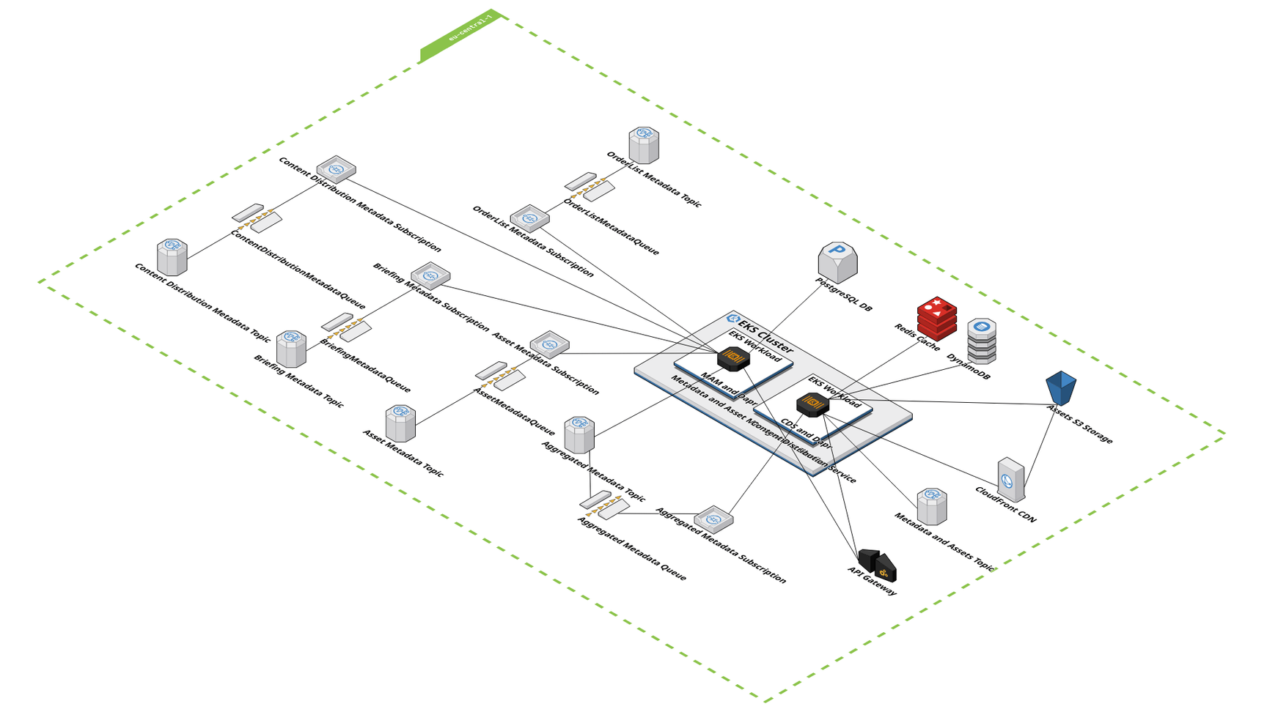
Solution Overview

Slide 6
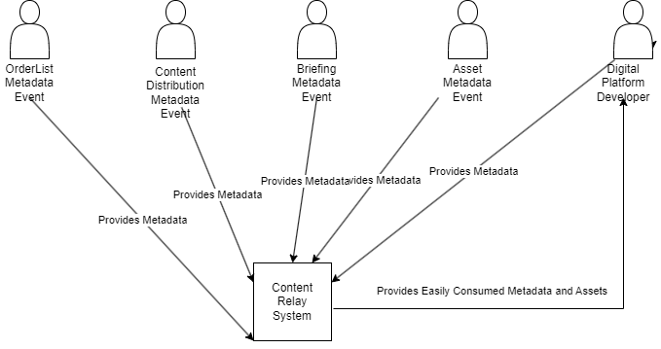
C4 System Context

Slide 7
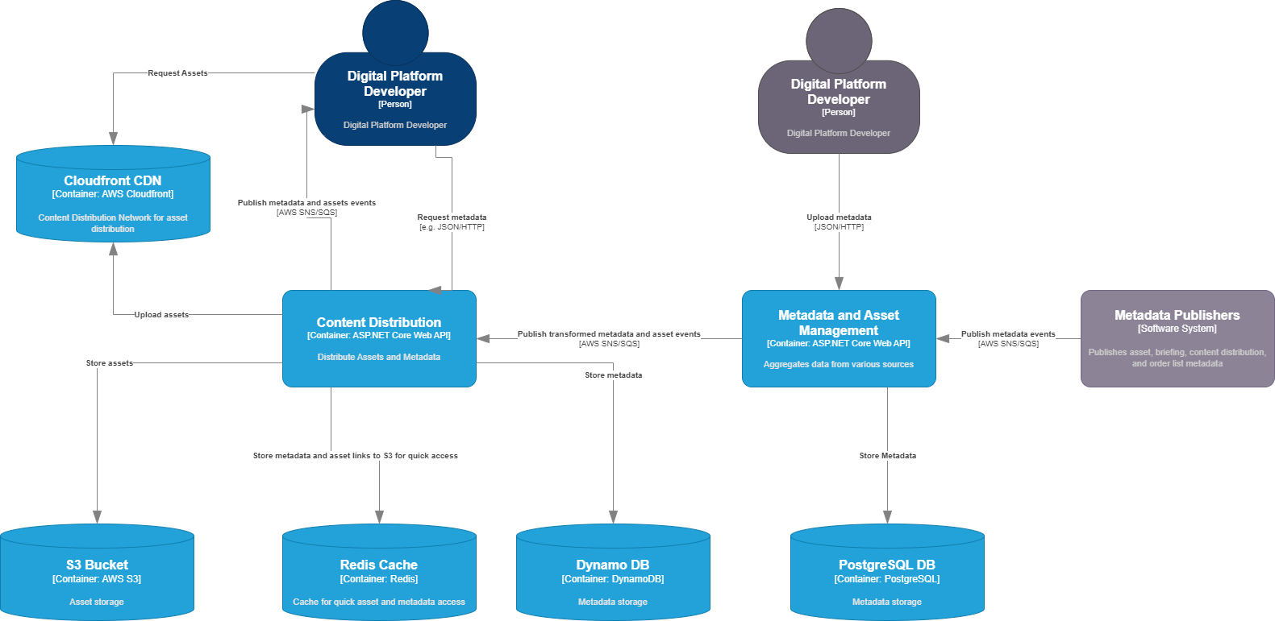
C4 Container

Slide 8

Challenges
A number of challenges quickly appeared in this case.
I wanted to have added more tests, and have scoped a MVP that was feasible in the given time frame.
Challenge 01
Challenge 02
Challenge 03
Way too much time was spent on the ACL
“We figure it out as we go” attitude might not always work when time is short.
No domain experts - or sparring partners.

Slide 9

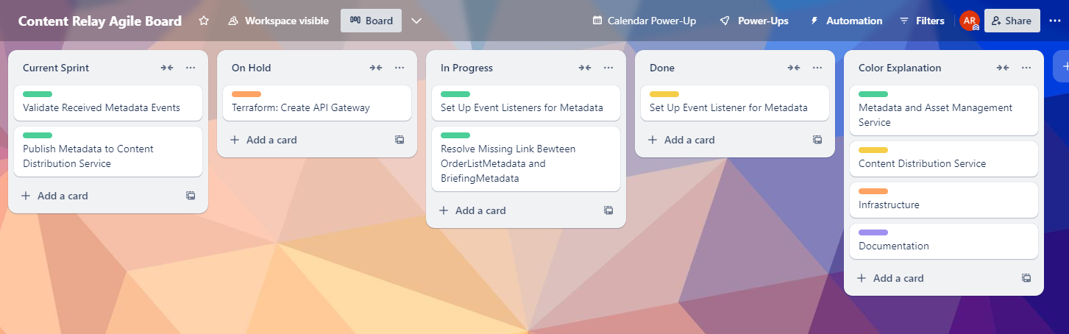
Collaboration
Context mapping.
Agile board.
Pair programming.
MVP scoping with Product Owner.

Slide 10


Conclusion
Scalability
Time is short
Dapr
Design was built with the idea that if we experience a spike in data coming in, we can scale the MAM service up - if lot of data was being read, we can scale the CDS instead.
Scope MVP according to time.
Dapr was chosen for this MVP because you can easily switch out the building blocks between development and production environments.

Slide 11


QA

